Slide 1
AI Fundamentals for Healthcare
Session 2 of 4 — Classical Machine Learning
January 16, 2026
Emera Innovation Exchange
cair.ca

Slide 2
Where We Got To
Last session we covered what a model is and how training works.
This session is about the models themselves, and about the harder question underneath them:
  Which model family suits which clinical problem
  What the data has to look like before any of it works
  How you tell a model that works from one that only looks like it works
That last point is where most clinical AI projects fail, and it gets most of our time today.
Notes:
Thirty seconds, no more. The purpose is to orient anyone who missed the previous session, not to re-teach it.

Slide 3
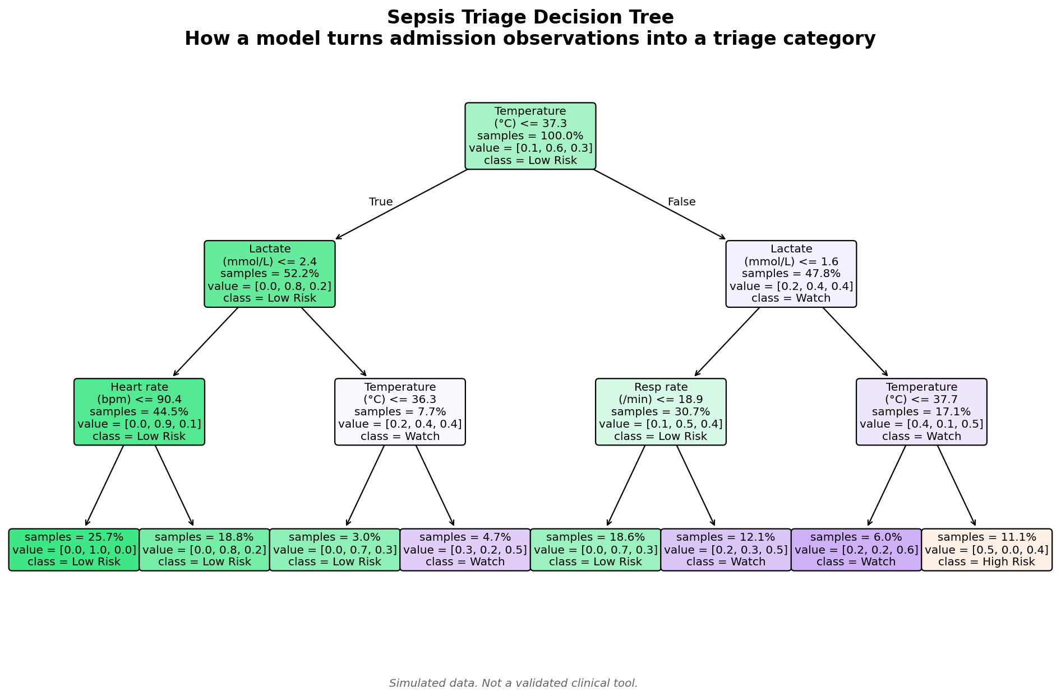
Decision Trees
Sepsis Triage Decision Tree
How AI Makes Clinical Triage Decisions

Slide 4

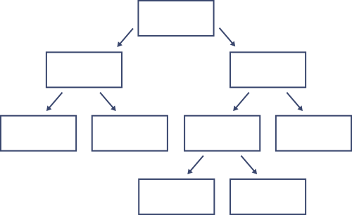
Decision Trees: Classification
Target: Low Risk, High Risk
Features: Lactate, Heart Rate, Resp Rate
Divide the training data
Condition that provides the best split
Continue until correctly divided
12, 8
Lactate < 2.0
9, 2
Heart Rate < 100
3, 6
Resp Rate < 20
9
2
3, 1
Heart Rate < 115
5
3
1

Slide 5
Decision Trees: Regression
Target: Length of Stay
Features: Age, Severity, Frailty
Divide the training data
Condition that provides the best split
Continue until correctly divided
6.1 days, n=100
Frailty < 0.3
4.9 days, n=35
Age < 65
6.8 days, n=65
Severity < 4
4.2 days, n=22
5.6 days, n=13
6.2 days, n=38
7.5 days, n=27

Slide 6
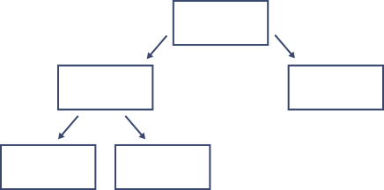
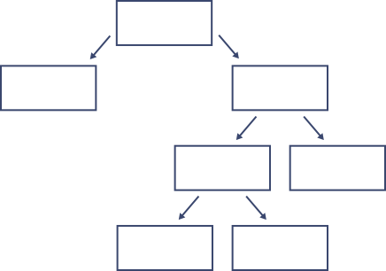
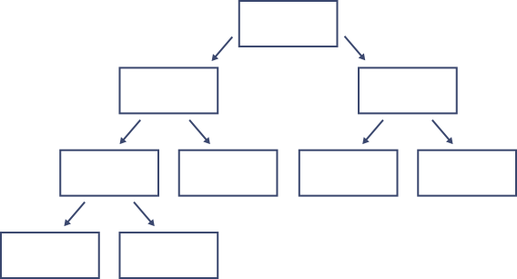
Random Forest
(of Decision Trees)
Create a large set of different trees
Select a random subset of features (bagging) at each node
Choose the most frequent classification or mean regression

Slide 7
Gradient Boosting
Train a model then determine the error for the training data
Train another model on the error and subtract its results from the original error
Continue this process to reduce the error
Use a validation set to avoid overfitting (regularization)

Slide 8
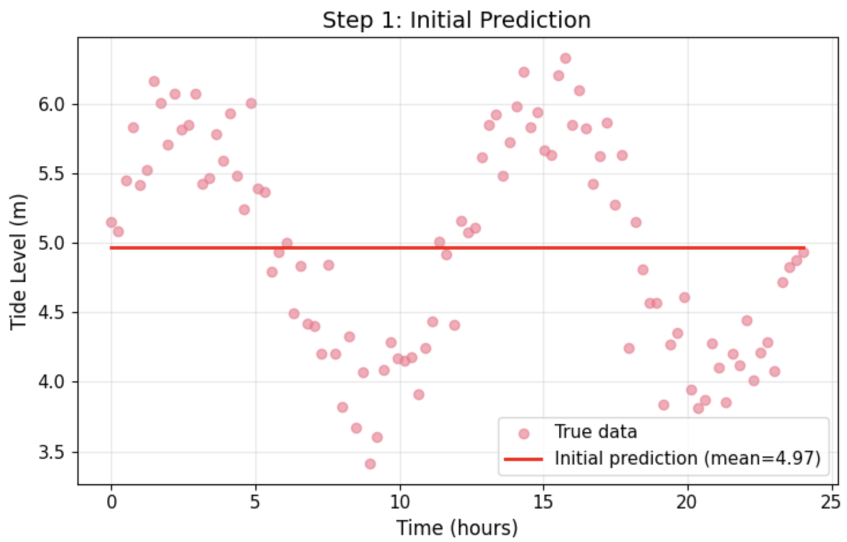
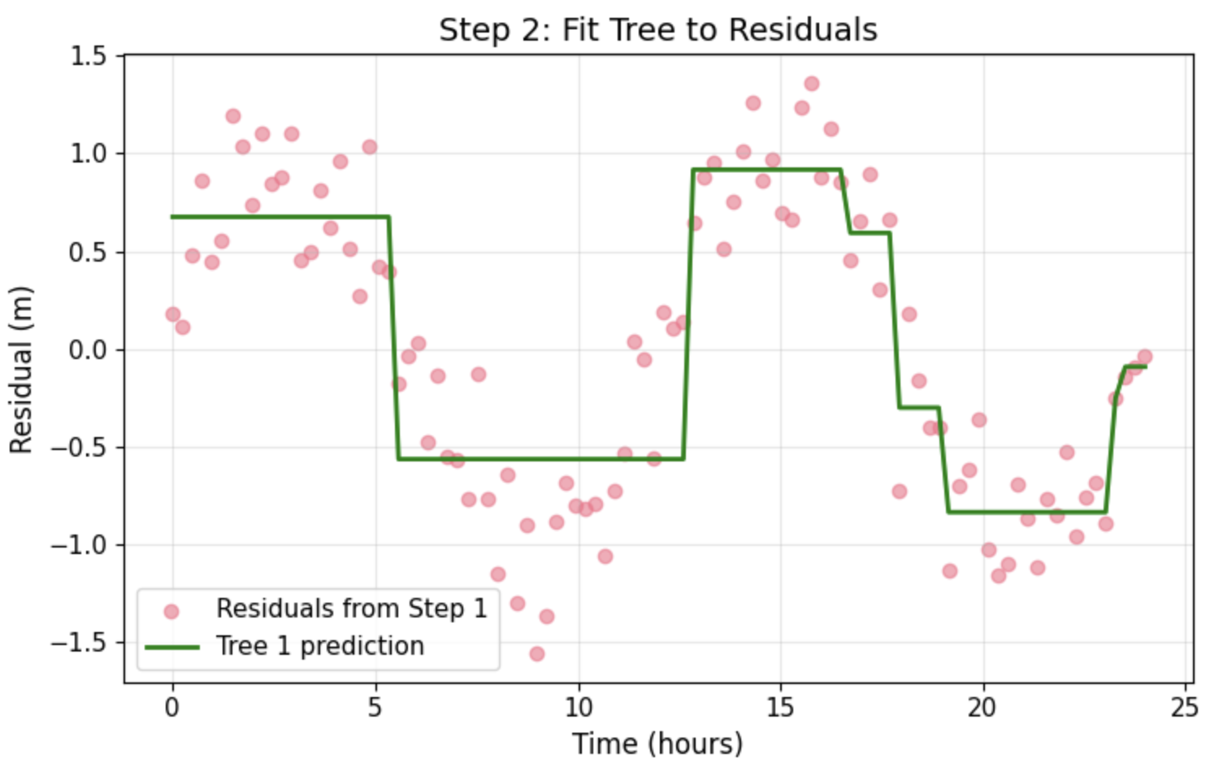
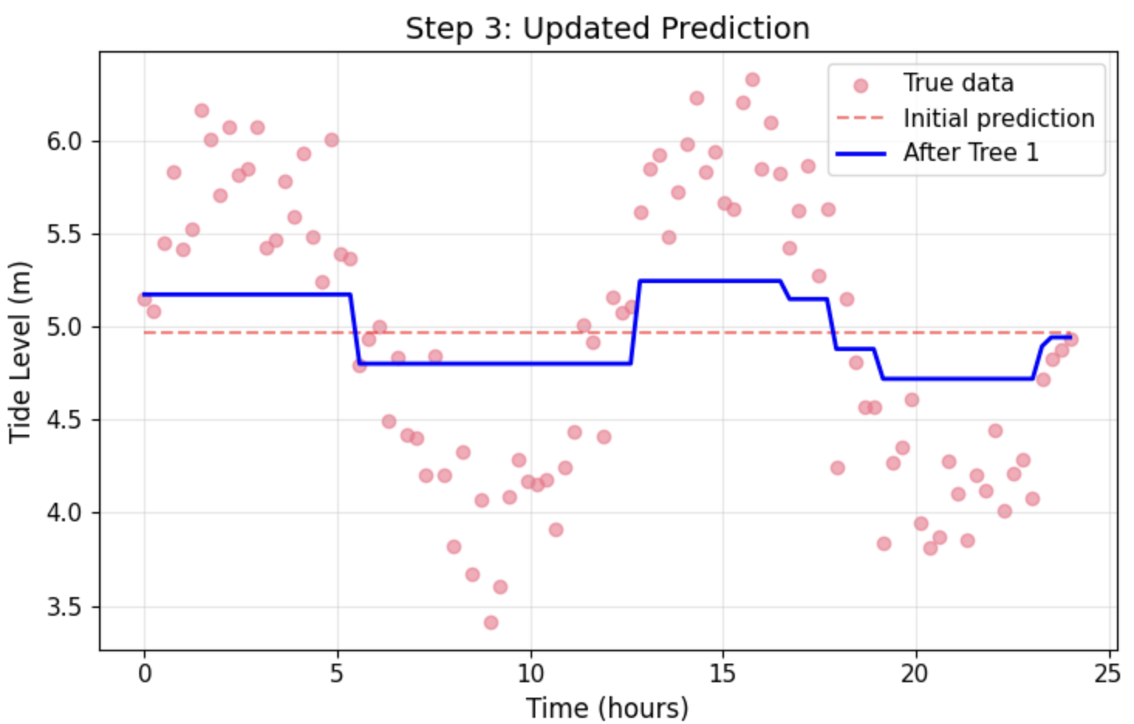
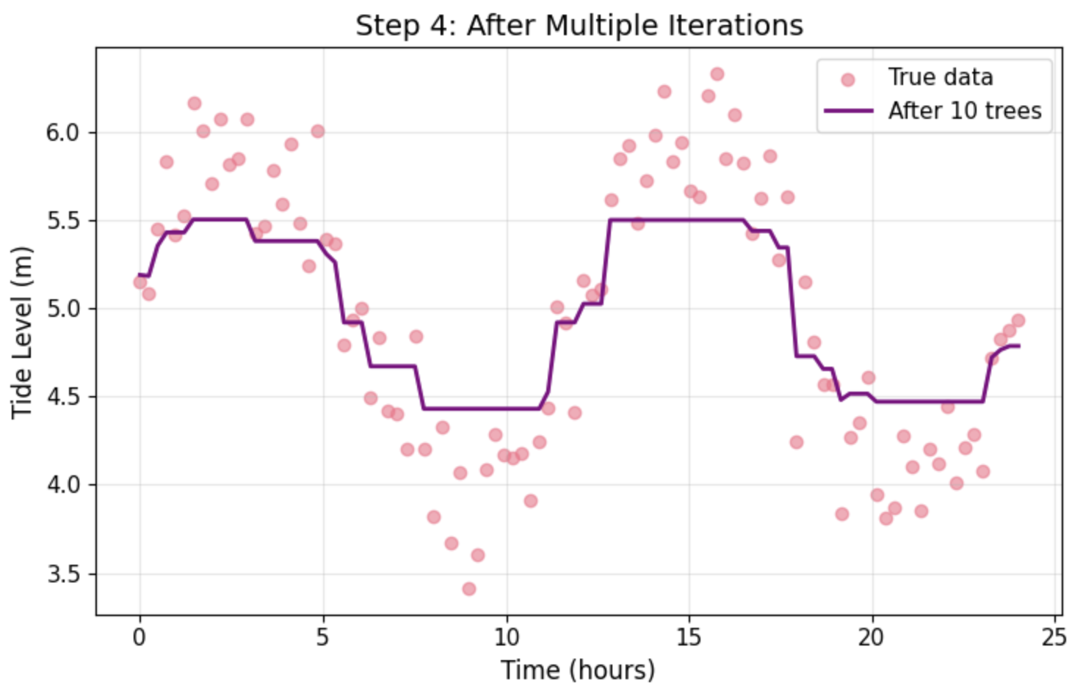
Gradient Boosting: Gradient Boosting Process Visualization
Step 1:
Initial Prediction
Step 2:
Fit Tree to Residuals
Step 3:
Updated Prediction
Step 4:
After Multiple Iterations

Slide 9
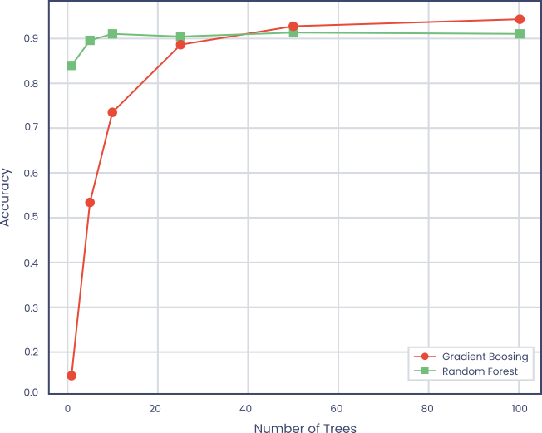
Improvement in Accuracy
Learning Progression: Number of Decision Trees

Slide 10
Classical Machine Learning
- Extreme Gradient Boosting
XGBoost is a supervised learning, decision-tree based ensemble model
It combines the results of multiple decision trees
XGBoost uses gradient boosting to iteratively build trees that minimize its loss function
It includes regularization (parameter value limits) to prevent overfitting
Designed for large, complicated data sets

Slide 11
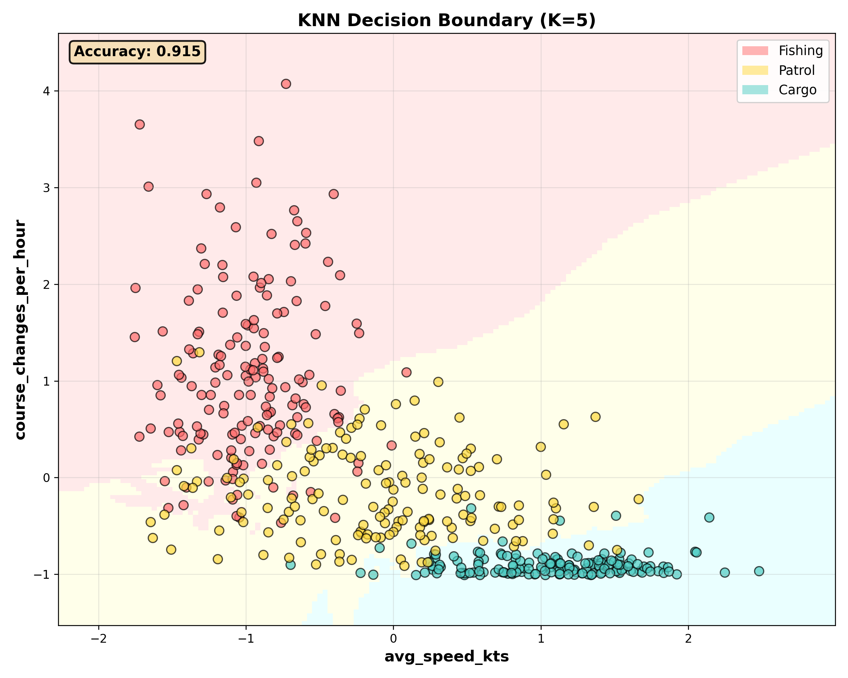
K-Nearest Neighbours (KNN)

Slide 12
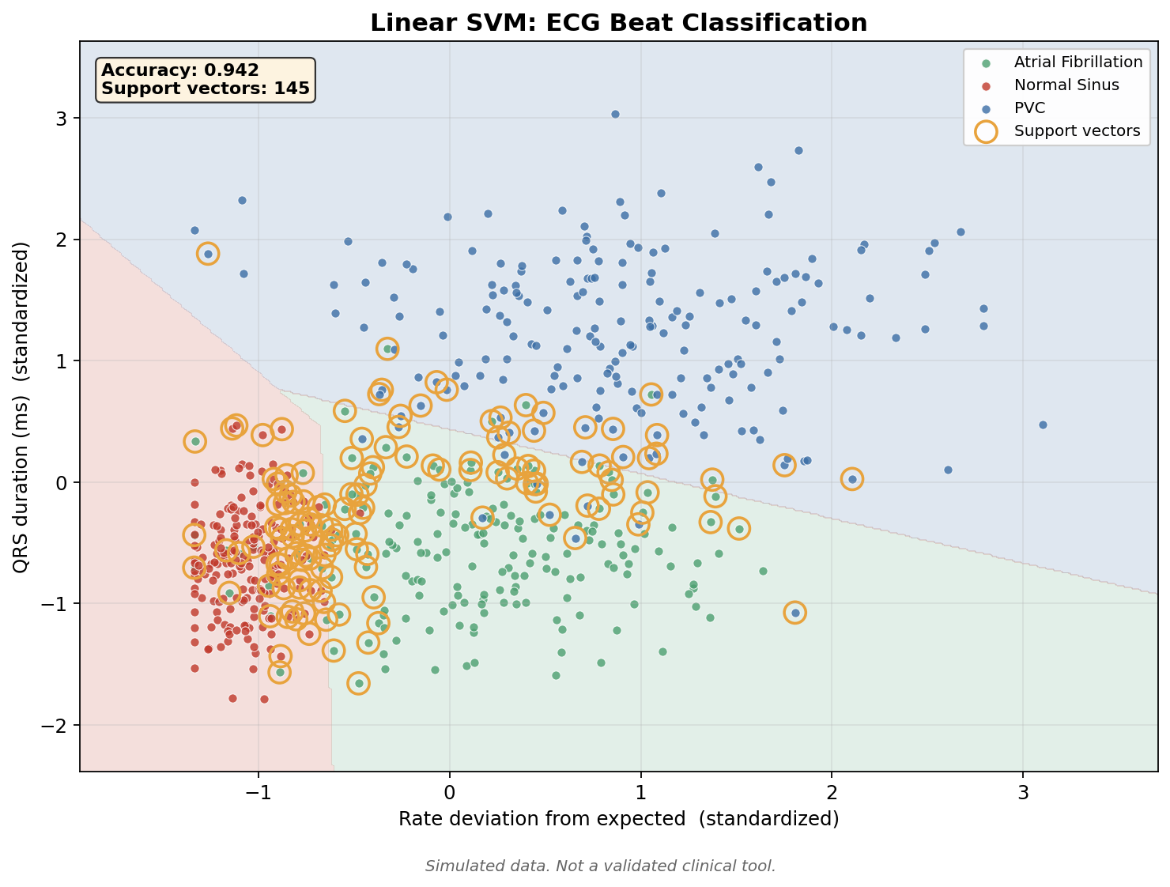
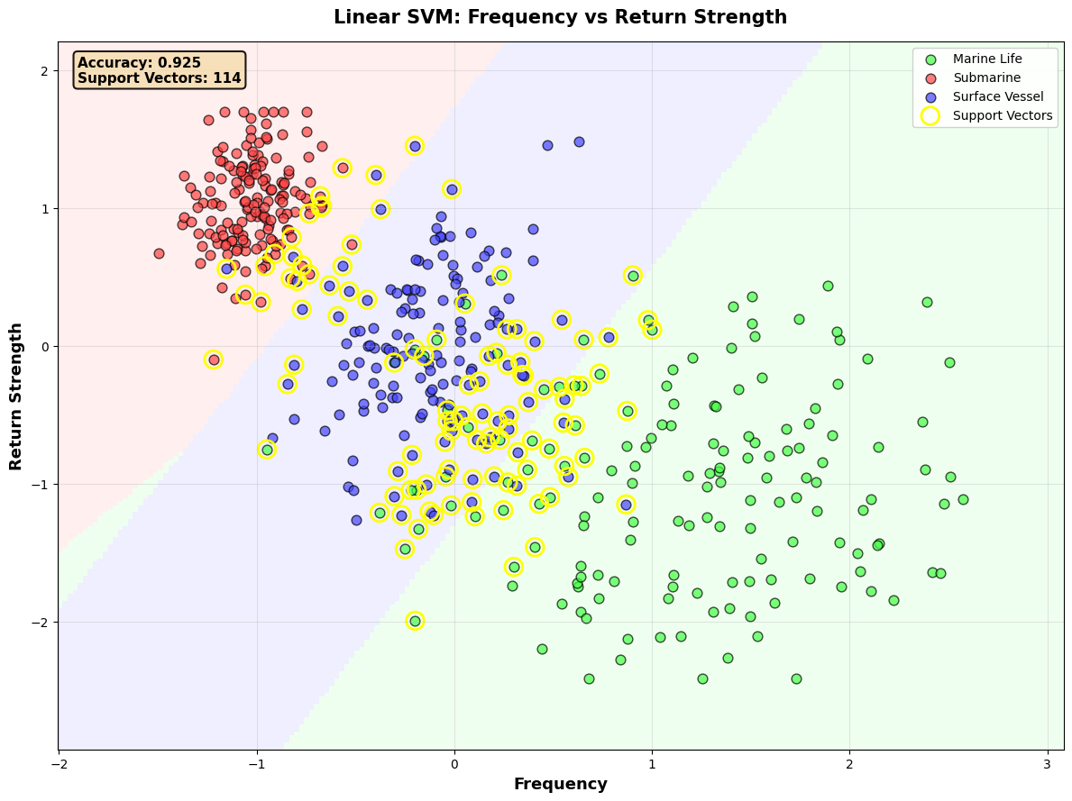
Support Vector Machines (SVM)
Linear SVM: Rate Deviation vs QRS Duration

Slide 13
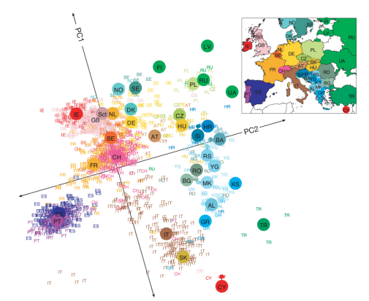
Principal Component Analysis
Novembre, John et al.
“Genes mirror geography within Europe.” Nature vol. 456,7218 (2008): 98-101. doi:10.1038/nature07331

Slide 14
Quality Data
The goal of training a machine learning model is to learn the patterns in the training data that will allow it to provide useful outputs
  when tested
  when used with new data
It is important that the training data contain a broad set of information and patterns and, if possible, that it contain a minimum amount of random noise
Knowledge of the domain is used to choose the set of features needed to provide sufficient information for the training
And the information should be correct (few errors)
For example, if the training data set contains labelled output, care should be taken that the labels are correct

Slide 15
Data Availability
When using historical data there is the danger of selecting features that contain information not available when the model is used. For example, consider the goal of predicting length of stay for an admission.
Not available
  Actual complications
  Discharge diagnosis
  Rehab bed wait
  Procedures performed
Available
  Presenting complaint
  Admission severity
  Planned procedure
  Prior admission date

Slide 16
Label Leakage
A model that looks excellent in testing is often reading the answer rather than predicting it.
Example: predicting sepsis from a feature set that includes the antibiotic order.
  The order exists because a clinician already suspected sepsis. The model learned the clinician, not the disease.
Common leaks in hospital data:
  Discharge diagnosis codes, assigned after the episode ended
  Transfer to critical care, which is a consequence rather than a predictor
  A test that is only ordered when the diagnosis is already suspected
The test to apply: could this value have been recorded before the moment the prediction is made?
Leakage does not appear as an error. It appears as suspiciously good performance.
Notes:
This is the single most common reason a clinical model looks brilliant in development and useless in practice. Worth slowing down for.
Good question for the room: what would leak in your own data? Someone usually names something specific to their service, and that lands better than the sepsis example.
About 5 minutes.

Slide 17
Missing Data Is a Clinical Decision
In most datasets a missing value is an accident. In clinical data it is usually a decision.
A test that was not ordered tells you the clinician was not concerned.
A patient with no overnight observations was probably well enough to be left asleep.
Filling the gap with the column mean erases that signal, and can reverse it.
Practical approach:
  Keep a missingness indicator alongside the imputed value
  Ask why the gap exists before deciding how to fill it
The matching trap: a model that learns 'many tests ordered' means 'seriously ill' will fail in a unit that orders those tests routinely.
Notes:
This is the slide that clinicians tend to find most obviously true and that data scientists most often get wrong. Use that.
The reversal at the end matters: a model that learns 'lots of tests means sick' breaks the moment it meets a unit with a different ordering culture. That is a site-transfer failure, and it connects to the external validation slide coming up.
About 4 minutes.

Slide 18
Overfitting vs Underfitting
The data used to train a machine learning model will contain both information and random noise
The data used to test the model will contain the same information but different random noise
We want the model to learn the information and ignore the noise
If the training is insufficient and it does not use all the information, we describe it as underfit
A model that is underfit will generally not perform well when tested using the test data
Similarly, if the model is over trained it will learn both the information and the noise in the training data
Again, it will perform poorly when tested since although it encounters the same information in the test data, it will encounter different noise

Slide 19
Regularization
In machine learning we use techniques like regularization and the use of a validation data set during training to avoid overfitting
Some machine learning models are so capable that they can essentially memorize every sample in a training data set
This will obviously produce exceptional results while training, but it will do poorly during testing
One way to avoid memorization and overfitting is to use regularization to add a penalty to the loss value if the parameter (coefficient) values are large
This encourages the model to “keep it simple”

Slide 20

Bias (inaccuracy)
Underfitted
Model Missing Information
Stable with Different Training Data

Slide 21
Variance
Overfitted
Model Contains Noise
Model Varies with Training Data

Slide 22
Bias vs Variance Tradeoff for Optimal Performance
Regularization
Prevent Overfitting

Slide 23
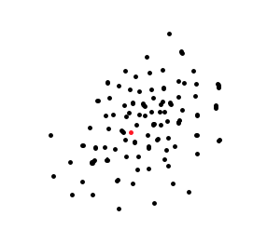
Typical –
Normal
Training Data
New Situation

Slide 24
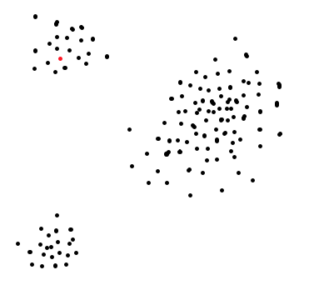
Typical –
Abnormal
Training Data
New Situation

Slide 25
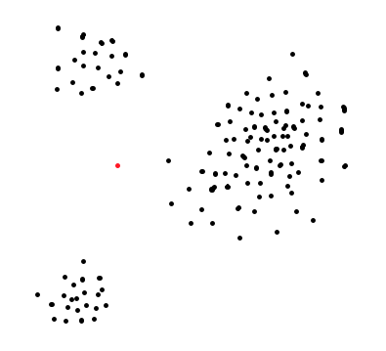
Atypical
Training Data
New Situation

Slide 26
Precision and Recall
Accuracy is the number of correctly classified items divided by the total number of items
When one outcome is far more common than the other, precision and recall are better than accuracy to measure model performance
Precision is the number of items correctly classified into a category, divided by the total number of items classified into in the category
Recall is the number of items correctly classified into a category divided by the total in the category

Slide 27
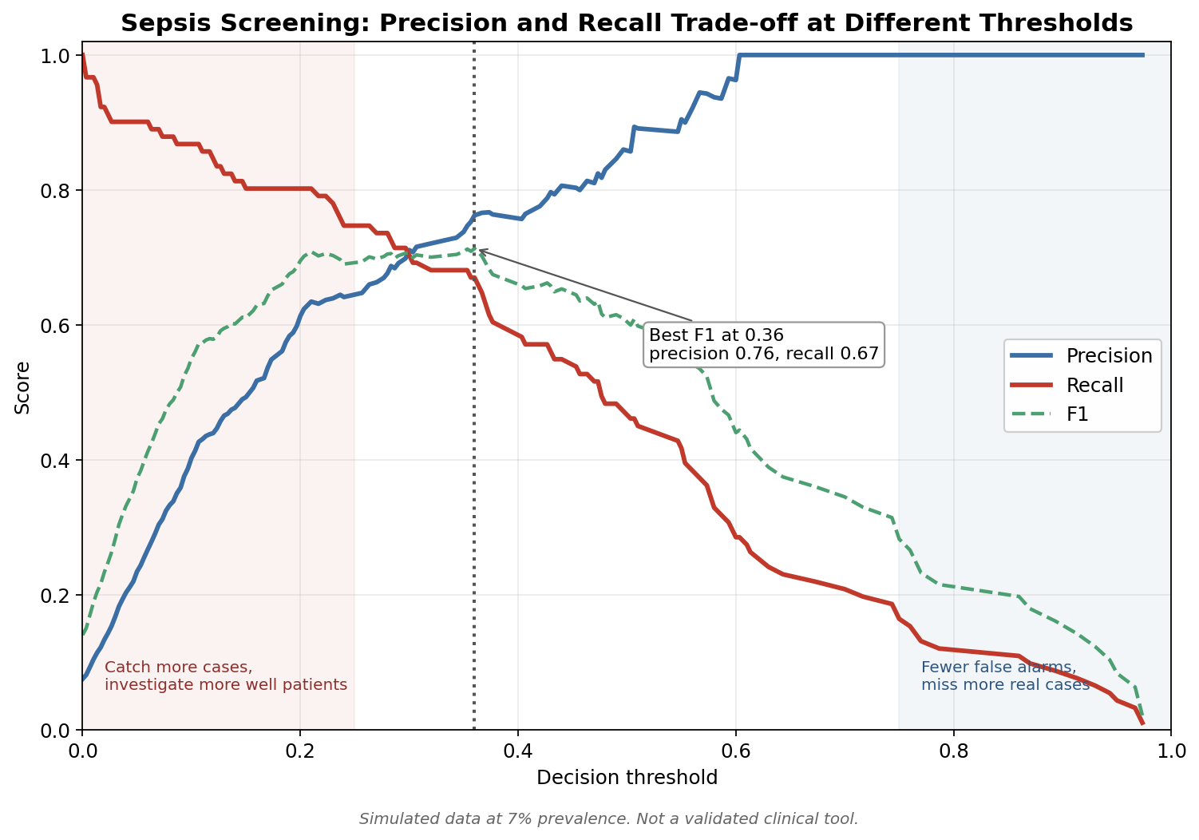
Precision vs Recall Trade-off
Classification at Different Thresholds

Slide 28
Calibration: Is 30% Really 30%?
Discrimination asks whether the model ranks patients in the right order. That is what AUC measures.
Calibration asks something different: when the model says 30%, does the event happen about 30% of the time?
A model can rank perfectly and still be badly calibrated.
This matters because clinicians act on thresholds. If the numbers are wrong, the threshold is wrong.
Check it with a calibration plot: predicted risk against observed rate, compared with the diagonal.
Calibration usually degrades when a model moves to a new site, a new case mix, or a later year.
  Recalibration is often enough to fix it, and is far cheaper than retraining.
Notes:
Most audiences have heard of AUC and have never heard of calibration. That gap is the reason this slide exists.
A concrete framing that works: a model that always says 5% when the true rate is 20% can still rank patients perfectly and win on AUC, while every number it reports is wrong. Nobody can set a threshold on it.
About 5 minutes.

Slide 29
What Counts as Validation
Internal validation: held-out data from the same source. The weakest claim, and the most commonly reported.
External validation: a different hospital, population or era. This is where most published models fail.
Prospective validation: run silently alongside usual care and compare. The first real test.
Impact study: does using it change outcomes? Rarely done, and the only question that ultimately matters.
Split by patient, never by row. The same patient on both sides inflates every number you report.
TRIPOD+AI (2024) sets out what a clinical prediction model should report. Use it as a checklist when reading a paper or a vendor claim.
Notes:
The four tiers are the spine of this session. If the audience remembers one slide, make it this one.
The split-by-patient point is not a technicality. In our own notebook a disposition model scored 100% with a row-level split and 49% once we split by patient. Same data, same model, one honest number and one meaningless one.
About 6 minutes.

Slide 30
Equity: Who Does the Model Fail?
A model trained on historical care learns historical inequity alongside clinical signal.
Obermeyer and colleagues (Science, 2019) examined a widely used US population-health algorithm:
  It used past healthcare cost as a proxy for health need
  Less had historically been spent on Black patients at the same level of illness
  So those patients had to be sicker to reach the same risk score
The algorithm was never given race. The proxy carried it.
Changing the target to a direct measure of illness substantially increased the proportion of Black patients identified for extra care.
Report performance separately by age, sex, ethnicity, language and deprivation, before deployment and after.
Ask what the label actually measures. Cost, referral and coded diagnosis are decisions, not conditions.
Notes:
Take this slowly and get the mechanism right, because the detail is what makes it persuasive: the algorithm was never given race. It used cost as a proxy for need, and the proxy carried the inequity.
The transferable lesson is the last line. Cost, referral and coded diagnosis are all records of decisions somebody made, not measurements of a condition.
Expect this to generate discussion. Leave room for it. About 8 minutes.

Slide 31
A Cautionary Case
A widely deployed proprietary sepsis prediction model was independently validated at an academic health system (Wong et al., JAMA Internal Medicine, 2021).
Measured discrimination was substantially below the figures the vendor had reported.
It missed a large share of sepsis cases, while generating alerts on a substantial fraction of all admissions.
Two failures compounding: the model underperformed, and the alert burden made the output hard to act on.
It had been in wide clinical use before this independent evaluation was published.
The lesson is not that the technique is flawed. It is that a vendor's performance figures are not evidence of performance in your hospital.
Notes:
Deliver this without triumphalism. The point is not that a vendor was wrong, it is that local validation is not optional.
Avoid quoting precise figures from memory. The shape of the finding is what matters: materially worse than advertised, high alert burden, already in wide use.
If someone asks whether their own tool has been externally validated, that is the best possible outcome for this slide.
About 5 minutes.

Slide 32
Session 2 — What to Take Away
Tree ensembles remain the workhorse for tabular clinical data. Start there.
Interpretability and accuracy trade off. Choose deliberately, and bring SHAP if you give up readability.
Accuracy misleads whenever the outcome is rare. Use precision, recall and calibration together.
The validation that counts is the one done somewhere else, prospectively.
Check who the model fails, not only how often it fails.
Most of the work is in the data, and most of the risk is in the label.
Next session: deep learning, large language models, and what deployment actually demands.
Notes:
Again, do not read it. Ask what they will check differently on Monday.
About 4 minutes.

Slide 33

Questions?

